Slide 1
The Extraordinary to Ordinary
Rose Murphy

Slide 2
Thesis
By creating awareness of behaviors outside the social norm by publishing it in the media will normalize and therefore allow others to accept those who are different from themselves.
-How building awareness and educating on social media can impact and create more inclusivity and diversity in societal norms

Slide 3
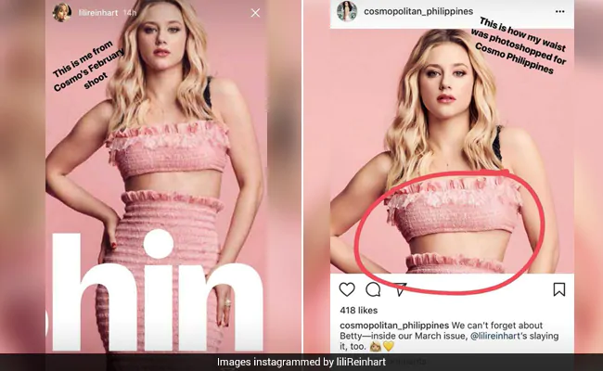
Body Image
Body Dysmorphia has been one of the biggest effects from social media
  Influencers using photoshop and creating unrealistic standards for beauty
  Marketing
    Victorias Secret Models
Lili Reinhart Cosmopolitan Incident

Slide 4
Body Positivity Era
-The more that celebrities and influencers come forward about their natural bodies, the more the beauty standard expands and normalizes to all body types
-Expanding opportunities to girls who aren’t the “standard beauty type” (Size 0, straight white teeth, small waist, thigh gap, flat stomach, etc.)
-“Young women who viewed the more realistic images reported more positive body image than those who viewed the standard, unrealistic, images” (Rodgers).”

Slide 5
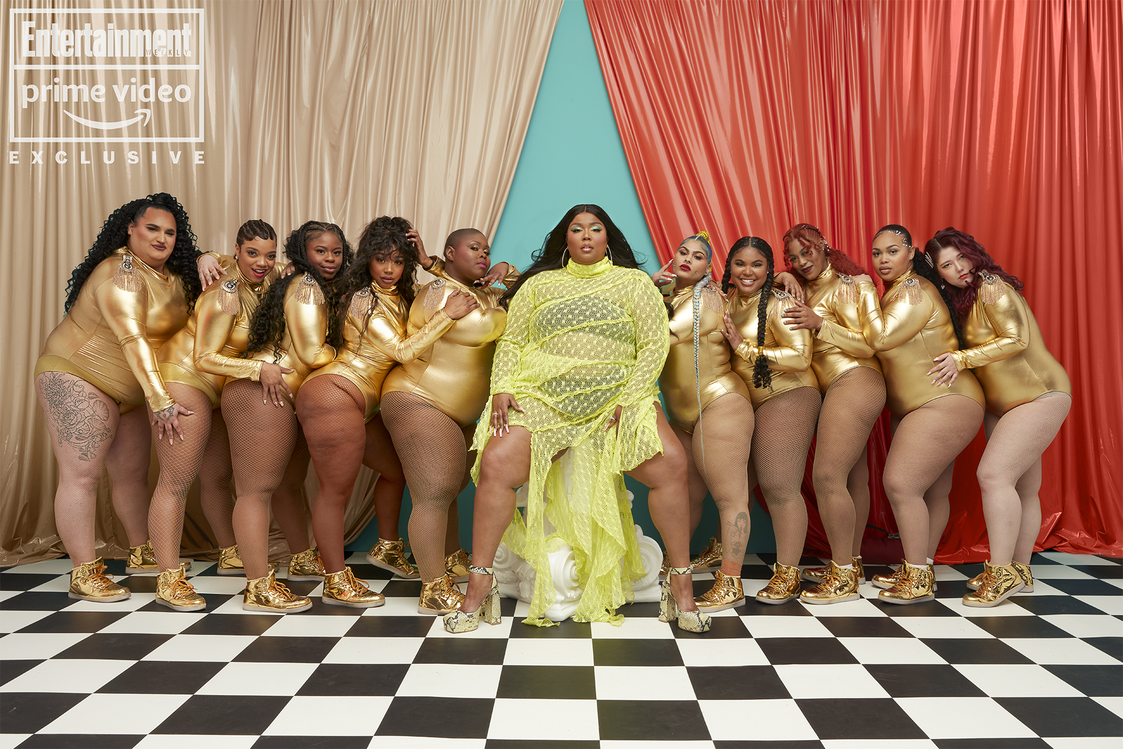
Lizzo
-Lizzo is a plus-sized pop star who has made a big impact on body positivity on the internet
-Utilizes her fame for body positivity
-Music
-Social media platforms
-Backup dancers

Slide 6
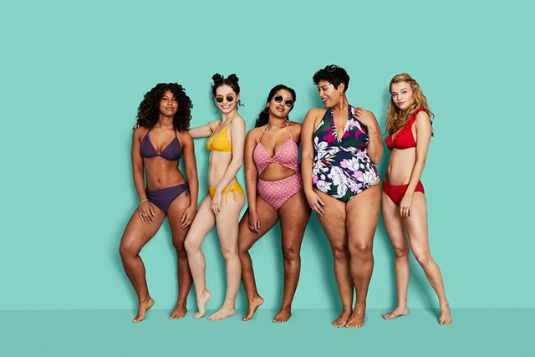
Impact
-With the change from promoting unhealthy standards of beauty to embracing natural qualities of bodies, the media and marketing of brands have completely changed to embrace people’s natural bodies
2019 Target Swim Ad

Slide 7
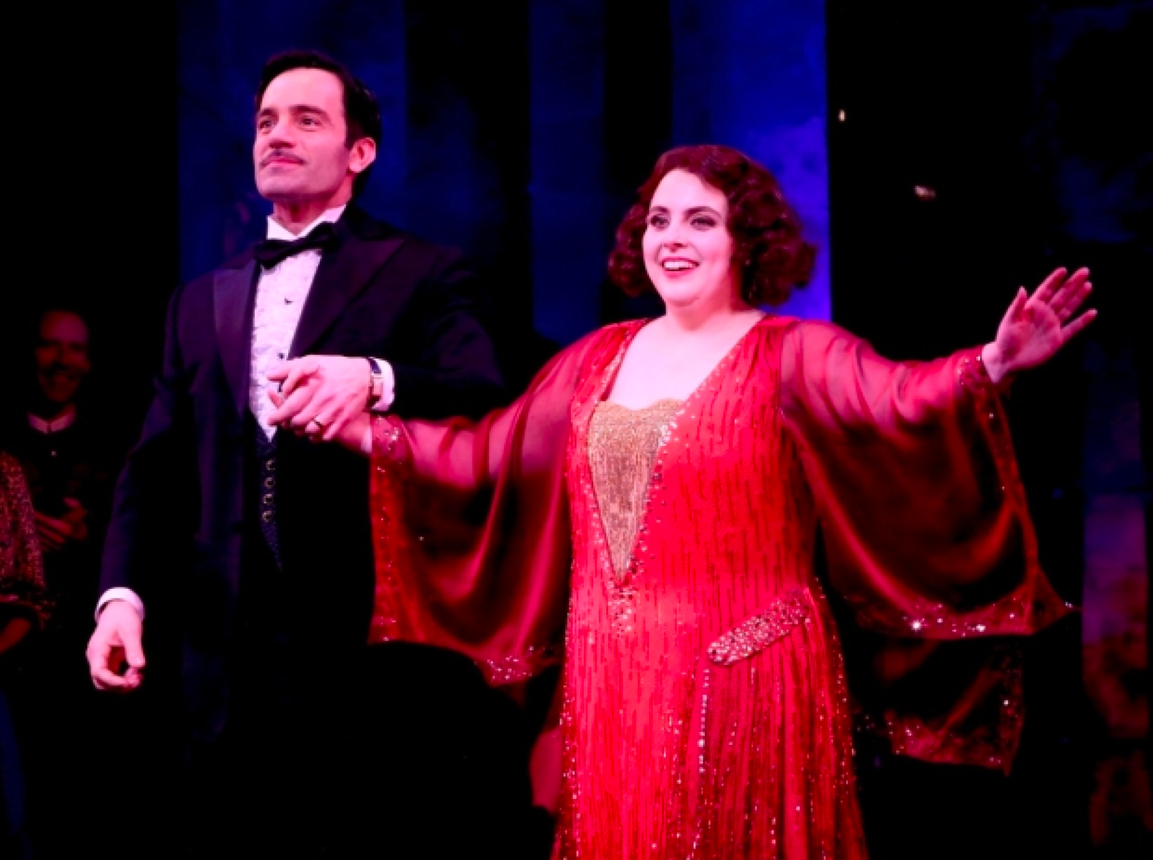
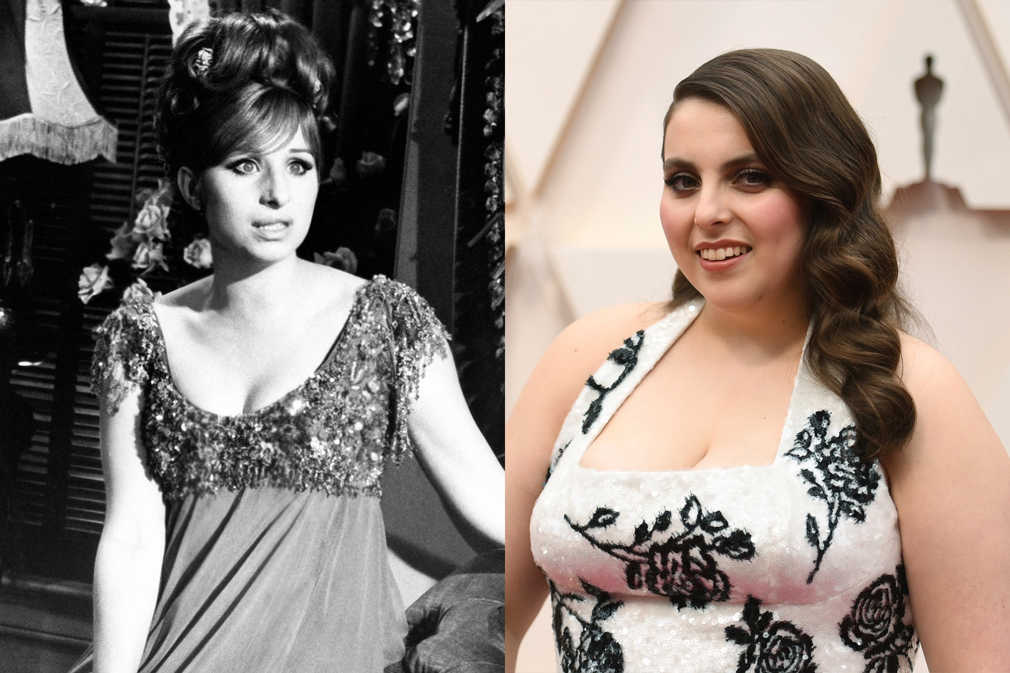
Impact
-The entertainment business is becoming more diverse with “type casting”
-Type Casting is casting actors into roles usually based off looks
-Most type casting would consist of the ingenue being the media’s beauty standard: Megan Fox, Grace Kelly, Meg Ryan
-Change: Beanie Feldstein in “Funny Girl” revival (2022)

Slide 8
Mental Health
-Taboo topic back in the day
-Social media and the internet have been great accessible platforms for resources and awareness of mental illnesses
-Social media has made a great impact for mental health awareness
-Licensed therapist Tiktokers
-Self Care Media
-People who struggle with mental illnesses expressing their struggles and experiences
-Normalizing and encouraging therapy on all platforms
-Instagram: affirmation posts, self care accounts, men's mental health awareness month (June)

Slide 9
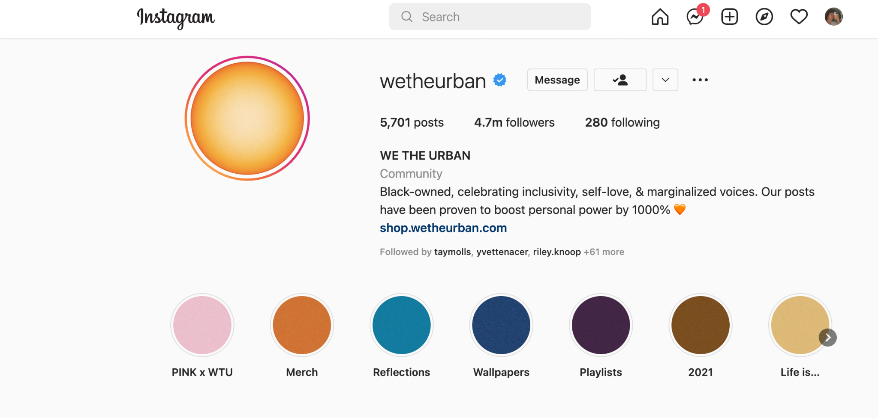
Impact
-The awareness of mental illness has helped many people who don’t suffer from it, to further understand it.
-It has given those who struggle with mental illness not only assistance and professional help, but a community where they feel safe, and feel less alone.
-According to the article “Effective use of social media platforms for promotion of mental health awareness”, the methods used to help people with mental illnesses were exemplified through campaigns or hashtags: “Buddies for Suicide Prevention”, #MigraineThePainfulTruth (etc.).

Slide 10
Disabilities
-People with physical impairments live in a whole different world that is unknown to the rest of society
-Personally, always a mystery
-The media has served as a great platform for people under these conditions to express themselves, form community and show the rest of the world more about their day to day lives

Slide 11
Impact
-Tiktok educates and normalizes the conditions of this community and helps develop that community
-Autism awareness-tok
-Autistic people creating videos expressing their experiences and what they personally are sensitive to to educate others
-Down syndrome
-Stutters, visually or verbally impaired
-1.4B views on #disabilityawarenesstiktok
-https://www.tiktok.com/tag/disabilityawareness?lang=en
-Videos of people expressing their experiences and how they are effected

Slide 12
Takeaways
-The studies that proved social media helps
-The change on how social media used to be super toxic (and still is), and changed a lot of the toxicity of it to create awareness, educate and create community
-The impact these awareness have created on society and on marketing and branding
-Models, advertising, etc.
-Increase in accessibility in public areas
-Amusement parks, museums, theatres
-Sign language interpreters

Slide 13
Works Cited
Hanson, Ralph E. Mass Communication: Living in a Media World. SAGE Publications, Inc, 2022.
Latha, K., et al. “Effective Use of Social Media Platforms for Promotion of Mental Health Awareness.” Journal of Education and Health Promotion, vol. 9, May 2020, p. 124. EBSCOhost, doi.org/10.4103/jehp.jehp_90_20.
Rodgers, Rachel F., et al. “#Take Idealized Bodies out of the Picture: A Scoping Review of Social Media Content Aiming to Protect and Promote Positive Body Image.” Body Image, vol. 38, Sept. 2021, pp. 10–36. EBSCOhost, search.ebscohost.com/login.aspx?direct=true&db=edo&AN=151779268&site=eds-live&scope=site.
Sweet, Kayla S., et al. “Community Building and Knowledge Sharing by Individuals with Disabilities Using Social Media.” Journal of Computer Assisted Learning, vol. 36, no. 1, Feb. 2020, pp. 1–11. EBSCOhost, doi.org/10.1111/jcal.12377.

